Slide 1
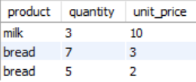

SQL PROJECT – HIRING ABC COMPANY
TASK – 1
CREATING TABLE:-
Create table shopping_history ( product varchar (20) not null, quantity int not null, unit price int not null)
INSERTING DATA:-
Insert shopping_history values ('milk', 3, 10), ('bread', 7, 3), ('bread', 5, 2)
SQL QUERY:-
select product, sum(quantity*unit_price) as total_price from shopping_history group by product

Slide 2

TASK – 2
CREATING TABLE 1:-
Create table phones ( `name` varchar (20) not null unique, phone_number int not null unique)
INSERTING DATA IN TABLE 1:-
Insert into phones values ('Jack', 1234), ('Lene', 3333), ('Mark', 9999), ('Anna', 7582)
CREATING TABLE 2:-
Create table calls ( id int not null unique, caller int not null, callee int not null, duration int not null)
INSERTING DATA IN TABLE 2:-
insert into calls values(25,1234,7582,8),(7,9999,7582,1),(18,9999,3333,4),(2,7582,3333,3),(3,3333,1234,1),(21,3333,1234,1)
SQL QUERY:-
with cte as ((select caller as phone_no, sum(duration) as duration from calls group by caller) UNION (select callee as phone_no, sum(duration) as duration from calls group by callee)) select p.`name` from phones p join cte c on p.phone_number=c.phone_no group by `name` having sum(duration)>=10

Slide 3
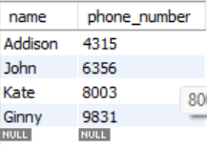
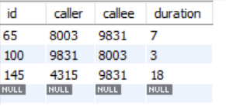

TASK – 2(2nd question)
Creating 1st Table:-
Create table phones1 ( `name` varchar (20) not null unique, phone_number int not null unique)
Inserting Data in 1st Table:-
Insert into phones1 values ('John', 6356), ('Addison', 4315), ('Kate', 8003), ('Ginny', 9831)
Creating 2nd Table:-
Create table calls1 ( id int not null unique, caller int not null, callee int not null, duration int not null)
Inserting Data in 2nd Table:-
insert into calls1 values(65,8003,9831,7),(100,9831,8003,3),(145,4315,9831,18)
SQL:-
with call_details1 as(Select caller as phn_no, sum(duration) as duration from calls1 group by caller UnionSelect callee as phn_no, sum(duration) as duration from calls1 group by callee)Select p1. `name` from phones1 p1 join call_details1 cd1 on p1.phone_number = cd1.phn_noGroup by `name` having sum(duration) >=10 order by p1. `name`

Slide 4
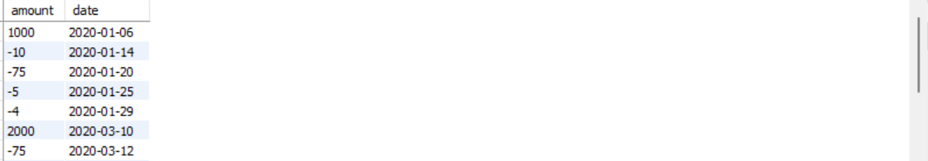

TASK – 3
Create table transactions ( amount int not null, `date` date not null)
Insert into
transactions values (1000,'2020-01-06'), (-10,'2020-01-14'), (-75,'2020-01-20'), (-5,'2020-01-25'), (-4,'2020-01-29'), (2000,'2020-03-10'), (-75,'2020-03-12'), (-20,'2020-03-15'), (40,'2020-03-15'), (-50,'2020-3-17'), (200,'2020-10-10'), (-200,'2020-10-10’)
SQL QUERY:-
select sum(t1.balance)-sum(t2.balance)from
(select 1 as id, sum(amount) as balance from transactions) as t1
Join
(select 1 as id, count(date)*11 as balance from transactions where month(date)=03) as t2on t1.id=t2.id

Slide 5
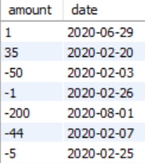

TASK – 3(2nd question)
Create table transactions1 ( amount int not null, `date` date not null)
Insert transactions1 values (1,'2020-06-29'), (35,'2020-02-20'), (-50,'2020-02-03'), (-1,'2020-02-26'), (-200,'2020-08-01'), (-44,'2020-02-07'), (-5,'2020-02-25'), (1,'2020-06-29'), (1,'2020-06-29'), (-100,'2020-12-29'), (-100,'2020-12-30'), (-100,'2020-12-31’)
Select * from transactions
SQL QUERY:-
select (t1.balance) - (t2.credit_charge) as total_balance from
(Select 1 as id, sum(amount) as balance from transactions1) as t1
Join
(Select 1 as id, count(`date`)*10 as credit_charge from (select *from transactions1 limit 4,5) as tt) as t2
On t1.id = t2.id

Slide 6

TASK – 3(3rd question)
Create table transactions2 ( amount int not null, `date` date not null)
Insert transactions2 values (6000,'2020-04-03'), (5000,'2020-04-02'), (4000,'2020-04-01'), (3000,'2020-03-01'), (2000,'2020-02-01'), (1000,'2020-01-01’)
SQL QUERY:-
Select t1.balance - t2.credit_charge as total_balance from
(Select 1 as id, sum(amount) as balance from transactions2) as t1
join
(Select 1 as id, count(`date`)*10 as credit_charge from (select * from transactions2) as tt)
as t2 On t1.id = t2.id

